Slide 1
project on IT FIRM SHADOW
Presented by, N.BHARGAVI(124E1A0506)

Slide 2
Project name:
32GB

Slide 3
Abstract
IT firm shadow means it give the description about IT companies present in our country.
This Website contain information like company logo, portfolio ,CEO’s ,location etc.,
Existing system of this project is manually they search about company.
Proposed system is using HTML, bootstrap,CSS ,PSQL databases to reduce time and burden.

Slide 4
Introduction
The main theme of this project is provide awareness about the profile of IT companies present in our country.
It will give all the details like company established year, capital, employability CEO’s in present and previous, location of company and recent projects etc.,
In this application infrastructure like it has company logo, description about companies in our country.

Slide 5
Existing system
There are many companies are providing their profiles individually on their own websites.
There is huge data, it is difficult to analysis exact data in peak stage before attending the interview.
Disadvantages:
Time taken process
Hard to search a particular company profiles individually.

Slide 6
Proposed system
We are going to provide all companies information in one website, which is helpful to students or user's to know about particular information about the company.
Advantages:
It gives the indetail information about IT company.
The intention of this website is to make user to face an interview with full company profile.
It takes less time.

Slide 7
Infrastructure
The infrastructure of this website contains:
IT company logo
Location
Portfolio
Sector(public/private)
Recent projects etc.,

Slide 8
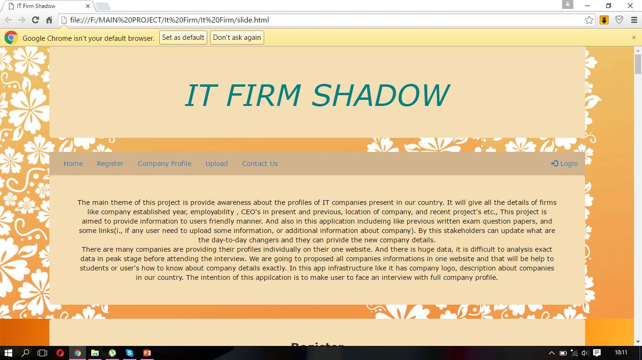

Slide 9
Modules
Registration
Company profile
Upload
Contact us
Admin
Database

Slide 10
Registration:
In the registration module, if any user want to access the company profiles present in IT firm shadow website then the user need to create a account using the registration form. This registration process is to know the details about the users who are accessing the website.
Company Profiles:
This module contains important information about companies which is needed to a job seeker. Each company contains important details like company established Year, Number of employees, CEO, Awards, Achievements, etc.,

Slide 11
Upload:
Upload module is mainly used by the user to share his/her interview experience, to upload any interview related documents.
Contact us:
Contact us module contain admin details, user can contact the admin for any queries.
Admin:
Admin maintains the website, he have all rights to update information, modify, delete.
Database:
In Database module, the database consist of registration details, company information, uploaded documents.

Slide 12
Software Requirements
FRONT END :
HTML
CSS
JAVA Script(for validations)
Bootstrap
BACK END :
PHP
JAVA Script
PSQL Database

Slide 13
HARDWARE REQUIREMENTS
Operating system : Windows 7 or above
RAM : 2GB
Hard disk : 40GB and above
Processor : Intel core i3(1.90 GHz) and upwards

Slide 14
Conclusion
By using this website time is reduced, easy to know about the IT company profile.The main intention of this application is to make users face an interview with full company profile.

Slide 15
.
THANK YOU

